Slide 1
LAUSD Local District East VEX IQ Challenge Leagues Kickoff Meeting
Please take one of each handout per team
View one of the League Postings While You Wait:
Navigate to www.RobotEvents.com in your browser
Login not needed until event registration
Click on Robot Competitions and select VEX IQ Challenge
Type Cudahy into City field and click Filter button
Click on the Name of the Early League
Scroll down to read the General Info tab
Click on the Agenda tab
Let us know if you see any errors or have any questions

Slide 2
LAUSD Local District East VEX IQ Challenge Leagues Kickoff Meeting Elizabeth Learning Center Friday, September 15, 2017
Jose Vaca, Elizabeth LC, Early Event Partner
Craig Sipes, LD East STEAM Coordinator, Late Event Partner
LeRoy Nelson, Los Angeles Robotics, Event Sponsor

Slide 3

VEX IQ Challenge Overview Video (4 min) https://www.youtube.com/watch?v=jrCb_n_l3tY

Slide 4
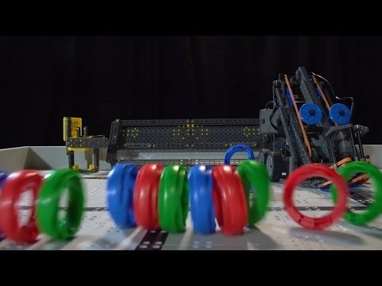
VEX IQ Challenge Ringmaster Video (2 min) https://www.youtube.com/watch?v=L7suUUs7fsU

Slide 5
Two LD East VEX IQ Leagues
Each league meets on five Fridays: 9/29, 10/27, 11/9, 12/1 and 1/12
First session is practice, next three are qualifying, last is championship
Each league needs at least 16 teams; keep both the same size
Early League meets 4:00 to 7:00 PM
LD East elementary schools that can get here early to help set up
Late League meets 4:30 to 7:30 PM
All other schools
Set up 3:00 to 4:00 PM, Clean up 7:30 to 8:00 PM

Slide 6
Both Leagues Meet In Gym – Sample Floor Plan

Slide 7
League Sessions
The first session on September 29 will be for orientation, training, and practice rounds for Teamwork Challenge and Skills Challenges. Teams will also sign up to provide one adult volunteer for one of the next three sessions and for the final session.
The second, third, and fourth sessions on October 27, November 9, and December 1, will begin with Robot Inspection, followed by Teamwork Challenge and Skills Challenge matches. Teams need to check in by 4:30 PM and robots need to pass inspection by 4:45 PM to be included in the Teamwork Challenge match schedule.
The final session on January 12, 2018 will be the Championship session. In addition to Robot Inspection, Teamwork Challenge matches, and Skills Challenge matches, the Championship session will include Robot Design and STEM Research Project judging and Finals matches and Awards.

Slide 8
Agenda for Early League Qualifying Sessions (Late League is 30 minutes Later)
3:00-4:00 PM Doors open. Set up fields 3:45-4:00 PM Volunteers check in 4:00-4:30 PM Teams check in 4:00-4:45 PM Robot Inspection 5:00-7:00 PM Teamwork and Skills matches 7:00-7:30 PM Teams depart. Doors close

Slide 9
Agenda for Early League Championship Session (Late League is 30 minutes Later)
3:00-4:00 PM Doors open. Set up fields 3:45-4:00 PM Volunteers check in 4:00-4:30 PM Teams check in 4:00-4:45 PM Robot Inspection 4:00-5:00 PM Judge Training 5:00-7:00 PM Judging, Teamwork and Skills matches 7:00-7:45 PM Finals matches and Awards 7:45-8:15 PM Teams depart. Doors close

Slide 10
Volunteers
Each team is expected to provide one adult volunteer for either the second, third or fourth session and one adult volunteer for the final session.
These volunteers will be scheduled at the first session.
A brief overview of the volunteer roles is one of your handouts. It is also available online at: http://link.roboticseducation.org/vrceventdocuments_volunteerresources_volunteerrolesoverview

Slide 11
One Handout Per Team
Game Description and Scoring
Game Manual
Field Appendix
Awards Appendix
STEM Research Project
Volunteer Roles Overview

